Slide 1
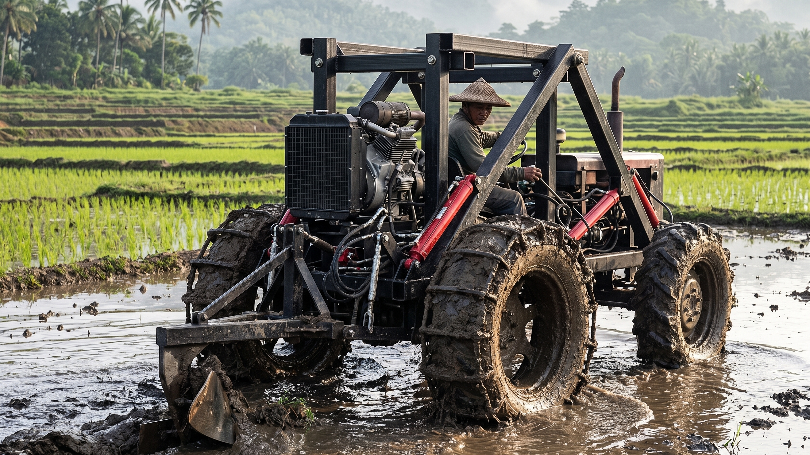
THE LIFETRAC PILOT
Open-Source Mechanization for the Rice Bowl — an evidence-based proposal
For: Department of Science and Technology • PhilRice • Department of Agriculture • Funding Partners
Evidence base: Villacorte (2026), Strategic Interventions for Rice Farming, Nueva Ecija | Open Source Ecology — Philippines | September 2026
Notes:
This deck targets funders and agencies, not farmers. Every claim is tied to the Villacorte 2026 Nueva Ecija study or to our Sept 2026 sourcing research. Full analysis: docs/16-villacorte-lifetrac-analysis.md.

Slide 2
THE EVIDENCE — VILLACORTE (2026), PSA
The Rice Bowl is losing capacity — and farmers say why.
44.6%
−24.3%
10–50%
1.7%
of Central Luzon's palay output comes from Nueva Ecija — the national rice bowl
drop in Nueva Ecija palay production — the region's decline is driven by the province
post-harvest losses in Philippine rice from inadequate processing, drying, storage
agricultural Total Factor Productivity growth (2021) — slow technological innovation
PSA, cited in Villacorte 2026
PSA, cited in Villacorte 2026
Villacorte 2026, lit. review
BSP DP 2024-10, cited in study
The farmers affected: aging (40–60), elementary-educated, 25+ years' experience, farming 2–3 hectares, earning ₱50,000–₱75,000 per harvest — with profitable dry seasons negated by rainy-season losses.
Study basis: 30 farmers surveyed in Llanera, Laur, Guimba (convenience sample). Directional field evidence — sufficient to justify a measured pilot, which is what we propose.
Open Source Ecology — Philippines | LifeTrac Pilot Proposal | Sept 2026
Notes:
Frame: national food security stake. Be upfront about the n=30 convenience sample — funders respect honest scoping. The pilot generates the representative data.

Slide 3
FARMER-REPORTED CONSTRAINTS (WEIGHTED MEAN, 4.0 = STRONGLY AGREE)
The farmers' own ranking — and where a machine intervenes.
Spiraling input costs (fertilizer, pesticides)
3.82
GREEN mechanization directly addresses
AMBER mechanization partially addresses (weather windows, irrigation works)
GREY out of scope — seeds, input prices, policy (partners' domain)
Erratic climate, typhoons, floods
3.76
Extreme weather events
3.66
Insufficient water supply
3.60
Exorbitant labor cost
3.56
Inability to adopt modernization / post-harvest
3.33
Lack of transport vehicles
3.20
Lack of farm machines
3.05
Source: Villacorte (2026), Tables 2–4. We present LifeTrac as one component inside the study's own action plan — not a standalone fix.
Open Source Ecology — Philippines | LifeTrac Pilot Proposal | Sept 2026
Notes:
The honesty slide: we claim the mechanization third of the problem and say so. Input costs (3.82) and seed quality (3.54) belong to PhilRice/DA programs — we complement, not replace.

Slide 4
THE PRODUCTIVITY CASE
Land preparation: from two weeks to one day.
Carabao (manual)
0.25 ha/day
Walking tractor (10–15 hp)
1.5 ha/day
Mini 4-wheel tractor (20–40 hp)
3 ha/day
▸ A cropping window gained — a 2–3 ha farm's land prep drops from ~2 weeks (carabao) to 1–1.5 days — on-time planting, every season.
▸ The labor line attacked — study Table 7: ₱9,800 planting + ₱8,640–16,200 harvesting labor per ha — the biggest controllable cost after fertilizer.
▸ Estimates to validate — rates are field rule-of-thumb figures; the pilot measures actual ha/day and ₱/ha and publishes them.
Open Source Ecology — Philippines | LifeTrac Pilot Proposal | Sept 2026
Notes:
Productivity ladder figures are compiled estimates (see docs/16 analysis §3) — present them as such. Large 60-70hp tractors reach 3-5 ha/day but are unaffordable and unrepairable locally.

Slide 5
WHY TIMING IS EVERYTHING — STUDY COST & RETURN DATA
One hectare, two seasons: the weather decides the income.
RAINY SEASON (inbred)
DRY SEASON (hybrid)
4,000 kg/ha
7,500 kg/ha
ROI 25–51%
₱12,164–24,164 net per season (at ₱15–18/kg)
ROI 81–117%
₱50,184–72,684 net per season (at ₱15–18/kg)
▸ Mechanization widens the window — faster land prep and harvest let farmers plant and reap inside short good-weather windows — converting rainy-season losses toward dry-season economics.
▸ Night operations double the machine's day — round-the-clock shifts finish time-critical work before storms arrive (details later in this deck).
Source: Villacorte (2026), Tables 6–9. Figures are study projections; actuals vary.
Open Source Ecology — Philippines | LifeTrac Pilot Proposal | Sept 2026
Notes:
Same hectare yields 4000 kg rainy vs 7500 kg dry; income swings ~6x. The mechanization argument is not just speed — it is weather-window insurance.

Slide 6
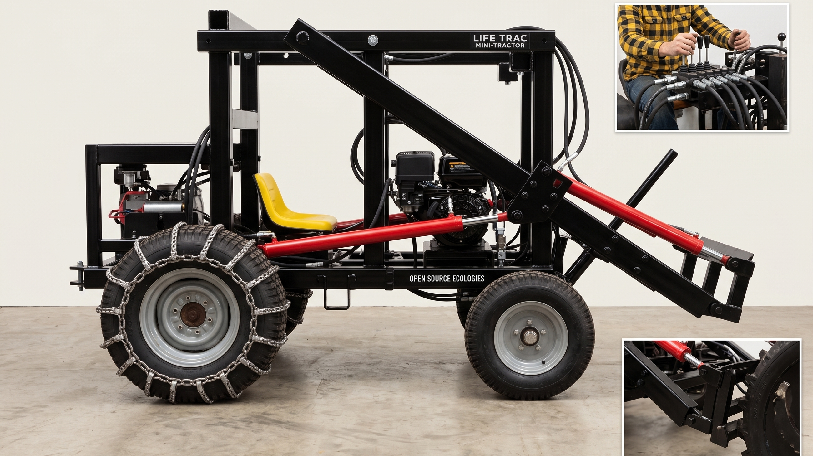
THE INTERVENTION
LifeTrac: an open-source mini tractor, built and repaired locally.
OSE LifeTrac IX / MicroTrac design • compact tracked utility tractor (~1 m wide) • 16–27 hp Power Cube • hydraulic quick-attach • documented to DIN SPEC 3105 open-hardware standard
Notes:
Machine class corrected per research: compact tracked utility loader, NOT a walk-behind kuliglig. Open documentation standard means any agency-funded build is fully auditable and replicable.

Slide 7
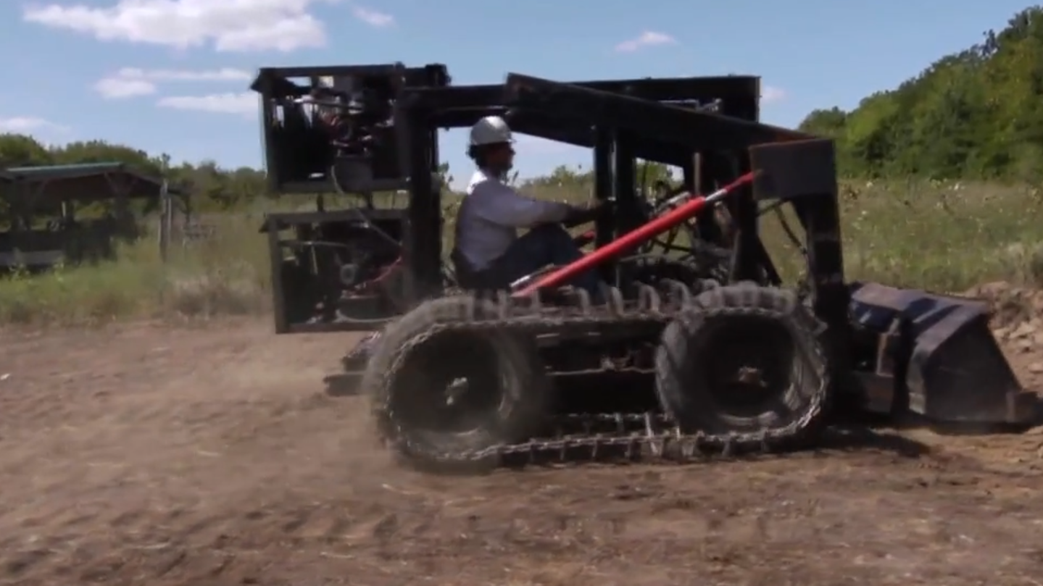
WHY OPEN SOURCE MATTERS TO GOVERNMENT
Every peso of public money buys an asset AND a capability.
Free plans → local workshops fabricate • TESDA/SUC-certifiable repair skills • no foreign parts dependency • the design is a permanent public good, not a one-time purchase
Notes:
Photo: real OSE LifeTrac prototype. For DOST: open-source deliverables mean funded R&D is reusable by any region. For TESDA/SUC (incl. NEUST, the study's own university): mechanic certification curricula. Answers the study's aging-farmer finding by giving youth an agri-tech entry point.

Slide 8
ALIGNMENT — THE STUDY'S ACTION PLAN ALREADY NAMES YOU
Villacorte's Table 10 assigns roles. LifeTrac plugs into each.
DA / RCEF / PhilMech
Study assigns: Procurement of farm machinery & equipment
LifeTrac: Pilot procurement of 2–5 locally built units
PhilRice
Study assigns: Certified seeds, technology training
LifeTrac: Training partner: operation & maintenance curriculum
DOST (PCIEERD / PCAARRD)
Study assigns: R&D and technology adoption
LifeTrac: Fund autonomy package: remote ops, LiDAR, night operations
TESDA / SUCs (incl. NEUST)
Study assigns: Skills training, youth engagement
LifeTrac: Mechanic certification per deployed unit
NIA-UPRIIS / LGU
Study assigns: Irrigation, local counterpart
LifeTrac: Off-season ditch, dyke, road works — year-round utilization
LBP / DBP
Study assigns: Expanded rice credit
LifeTrac: Cooperative equipment loans against a shared asset
Source: Villacorte (2026), Table 10 — Proposed Action Plan; LifeTrac column is our proposal.
Open Source Ecology — Philippines | LifeTrac Pilot Proposal | Sept 2026
Notes:
This is the slide each agency photographs. Every row is quotable from the study's Table 10 — we are not inventing mandates, we are volunteering to execute them.

Slide 9
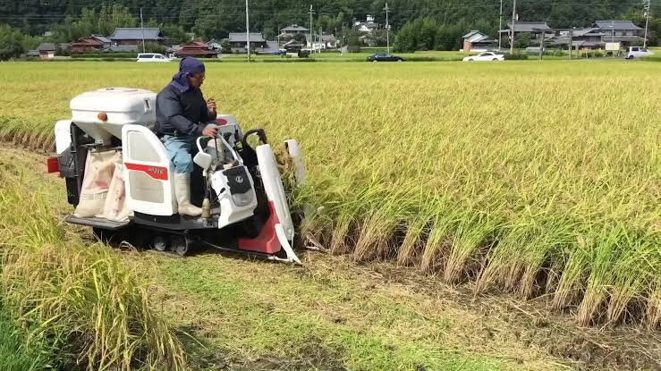
DEPLOYMENT MODEL
Subsidize the association, not the individual.
▸ The study calls for it — Table 10: 'Create eligible farmer association' — the co-op is the machine's owner, operator pool, and security layer.
▸ Utilization is the math — ~30 smallholders × 2–3 ha ≈ 75–90 ha per association keeps one machine near capacity during prep windows.
▸ No individual debt — subsidy + co-op ownership avoids the informal-lender trap the study documents (WM 3.36–3.53).
▸ Cultural fit — the shared carabao tradition, mechanized — familiar governance, new horsepower.
Shared machines, shared harvests — the cooperative model.
Open Source Ecology — Philippines | LifeTrac Pilot Proposal | Sept 2026
Notes:
Group ownership is what makes the subsidy defensible: one ₱250k machine serves ~30 families. Also the answer to asset security (community custodians) — see autonomy slide.

Slide 10
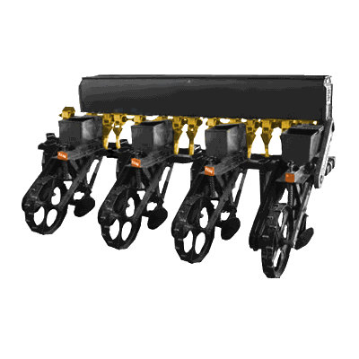
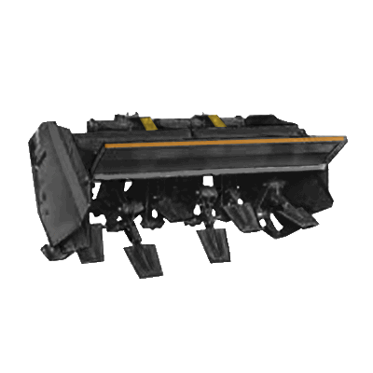
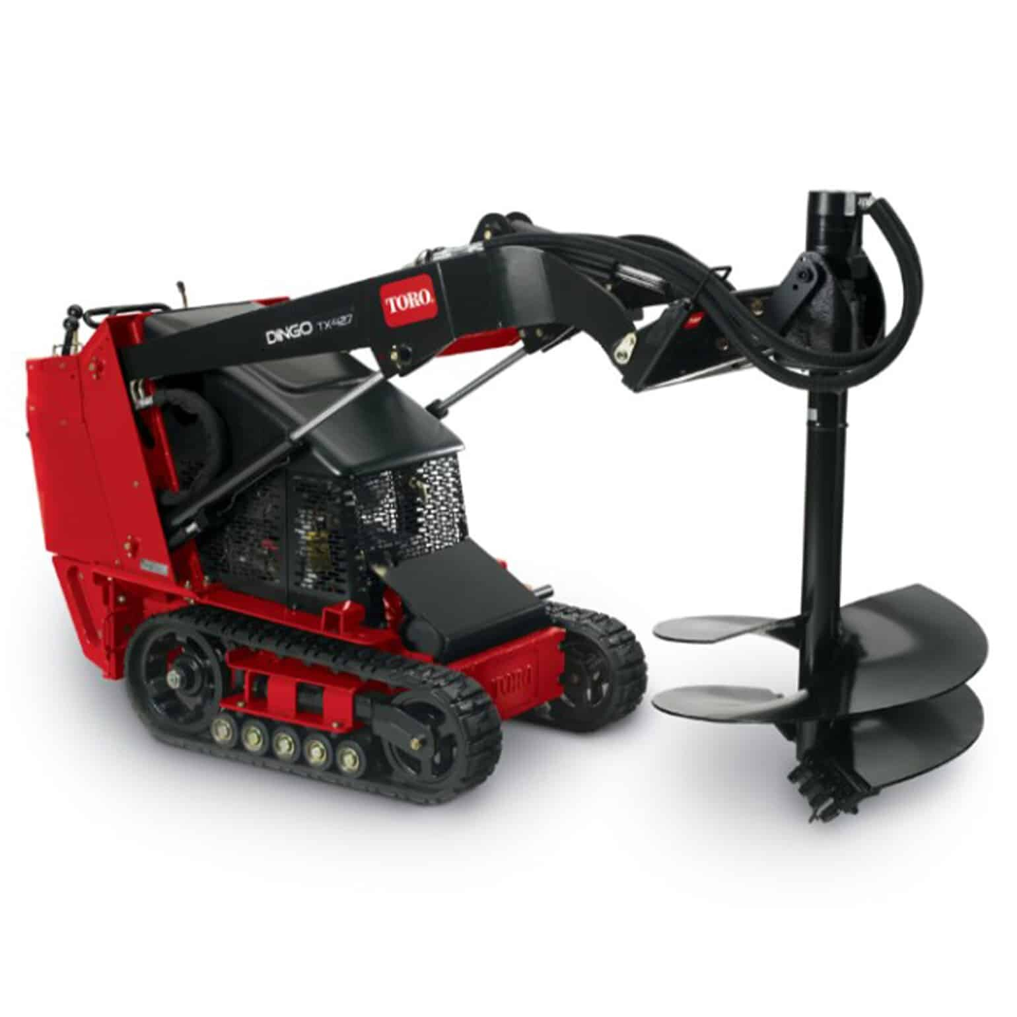
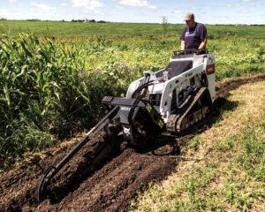
ATTACHMENTS — ONE MACHINE, THE WHOLE CROP CYCLE
Swap tools in minutes; work all year.
Seeder
Spader / Tiller
Auger
Trencher
even, fast row seeding
seedbed in one pass
posts, trees, drainage
irrigation & drainage ditches
Plus bucket, pallet forks, plow, trailer — the trailer answers the study's 'lack of transport vehicles' (WM 3.20), freeing farmers from forced same-day sales to middlemen. Attachment photos show tool concepts on comparable compact machines.
Open Source Ecology — Philippines | LifeTrac Pilot Proposal | Sept 2026
Notes:
Trencher ties to the water-supply constraint (WM 3.60) via ditch maintenance; trailer ties to transport (3.20) and middleman price manipulation (3.38). Auger/trencher photos are concept references.

Slide 11
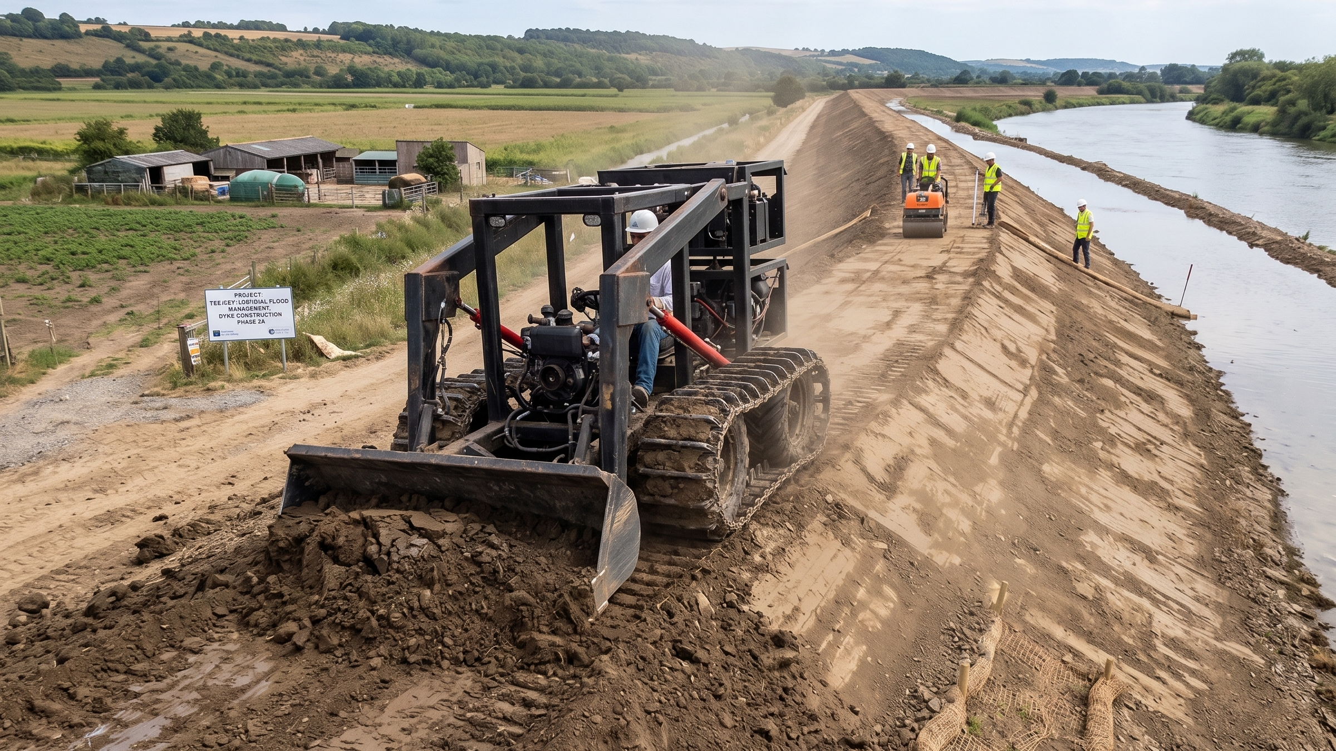
OFF-SEASON UTILIZATION — THE LGU DIVIDEND
A publicly owned machine never sits idle.
Farm-to-market road repair • dykes, earthworks, drainage • flood-control construction before typhoon season • utilization across seasons is what makes the subsidy arithmetic work
Notes:
Photo: LifeTrac concept on a flood-management dyke project. Flood works answer the study's top climate constraints (3.76/3.66) structurally, not just operationally.

Slide 12
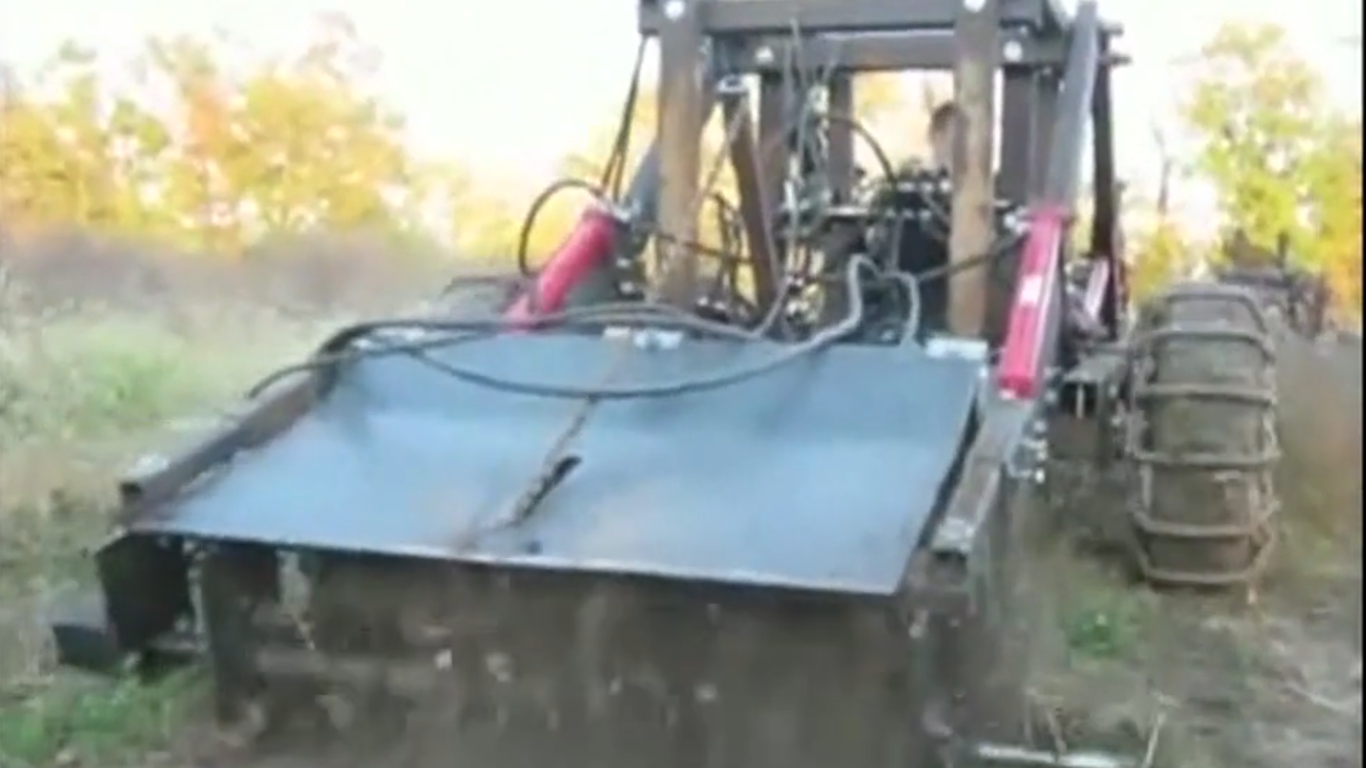
DOST R&D TRACK — NIGHT, REMOTE & DRONE OPERATIONS
Double the machine's day; protect the worker; beat the storm.
Agronomic gain
2× asset utilization
Worker safety
Weather-window catching
cooler, calmer nights: less spray evaporation & drift; pollinators untouched
24/7 shifts double hectares per machine — no second tractor needed
no Central Luzon heat stress; operators remote from spray, mud, flood
finish planting/harvest before the typhoon arrives
Notes:
Photo: prototype tilling at dusk. Also: thermal/LiDAR sensing works BETTER at night (no solar reflection noise); RTK-GPS holds cm-grade paths in darkness. Challenges priced in: dew protocols, BVLOS/CAAP regulation compliance, capex — see docs/16 analysis §4.

Slide 13
AUTONOMY & ASSET SECURITY — OPERATING IN LOW-TRUST ENVIRONMENTS
The guidance sensors double as the security system.
▸ Falling marginal cost — shared control terminal + field Wi-Fi repeater mesh; per-tractor add is a ~₱100k LiDAR module — cost per machine drops as the fleet grows.
▸ LiDAR as perimeter grid — 3D range-anomaly detection flags any unexpected human, animal, or vehicle in an empty night field — intrusion detection with no extra hardware.
▸ Wi-Fi human detection — repeater mesh senses large moving bodies approaching the machine — covers LiDAR dead zones; augments human custodians, never replaces them.
▸ Automated response chain — anomaly → site alarms + floodlights + cellular/radio alert; geofence breach or link loss → engine kill switch, hydraulics locked.
THE DECISIVE LAYER IS SOCIAL. Technology deters; community prevents. Co-ownership through the farmer association — plus local custodians and security partnerships — is the real anti-theft system. Tamper-evident housings with tilt/shock sensors protect the ~₱100k sensor head and terminals.
Open Source Ecology — Philippines | LifeTrac Pilot Proposal | Sept 2026
Notes:
Funders will ask 'what stops theft of autonomous gear in an open field?' — this slide is the answer. Physical hardening + geofenced immobilization + community custodianship. See docs/16 analysis §5.

Slide 14
RISKS WE ARE PRICING IN — NOT WAVING AWAY
What can go wrong, and the mitigation we budget for.
Challenge
Impact
Mitigation
High capital expense
thermal drones, RTK guidance, night lighting
cooperative / custom-hire sharing — same model as the tractor
Dew & excess moisture
spray wash-off; night-tillage clogging/compaction
RH + soil-moisture monitoring protocol before launch
BVLOS & night-flight rules
CAAP regulatory hurdles for drones
certified autonomous units, geofenced fields, licensed operators
Import price competition
Chinese mini loader lands at ₱281k–343k
local repair uptime, local parts, scale + local motors (next slide)
Unresolved Power Cube BOM
engine-pump interface not yet finalized
engineering completion funded as pilot milestone — build starts after sign-off
Open Source Ecology — Philippines | LifeTrac Pilot Proposal | Sept 2026
Notes:
Last row is from our own sourcing research (MicroTrac Build Cost Research 260910): the Power Cube interface BOM is unresolved and the research recommends WAIT until it is. We tell funders this ourselves — milestone-gated funding handles it.

Slide 15
ECONOMICS & THE PATH TO COST LEADERSHIP
Above import price today. Below it at economic quantities.
LifeTrac — materials + direct labor ONLY
₱247,548
excludes indirect labor, overhead, tooling, trial and error
LifeTrac — realistic all-in, first units
₱900,000
the number to budget the pilot against
Imported Chinese mini loader (landed, ready to work)
₱312,000
Estimates, Sept 2026 sourcing research (₱62.51/USD). Import range ₱281k–343k (Rippa RS06 class, delivered). We are NOT cheaper today: ₱247,548 is a price-optimized direct-cost model, and our own conservative draft BOM for the same machine reads ~₱358,000 materials (₱420,000 with contingency) before any labor at all. At parity the difference is lifetime — local repair, local parts, no import downtime.
THE PATH BELOW IMPORT PRICES
① Economic quantities (build in batches) ② Local motors — separate engagement ③ Local batteries — separate engagement ④ Local content + investment
With sufficient investment, local content reaches Chinese-level costs — and the value stays in the Philippine economy. Motors and batteries are explicitly outside this two-year scope.
Open Source Ecology — Philippines | LifeTrac Pilot Proposal | Sept 2026
Notes:
CORRECTION (Justin, 2026-09-10). The slide previously claimed 'At parity today. Cheaper than imports with scale and local content.' That was wrong in the direction that matters: ₱247,548 is materials (₱194,548) plus ₱53,000 of DIRECT labor from a price-optimized model — it excludes indirect labor, overhead, tooling and trial and error. Our own conservative draft BOM (boms/microtrac-bom-ph-v1.0.md) reads ~₱358,000 materials, ₱420,000 with contingency, before any labor. Against a factory-built import that lands finished, tested and warranted at ₱281k–343k, we are MORE expensive today. Funders trust an honest gap more than a flattering one — and the gap is the argument for the subsidy. Local motors and batteries are SEPARATE engagements, not part of this scope. 10kW motor + controller lands at ~₱12.5k; the battery is the cost driver. docs/11 and docs/12.

Slide 16
THE ASK — A MEASURED PILOT IN THE STUDY'S OWN MUNICIPALITIES
Fund the pilot. We publish the numbers.
SITE: Llanera, Laur, Guimba (Nueva Ecija) — NEUST as academic M&E partner
COST: budgeted honestly at ~₱900,000 all-in per first unit — ₱250k parts → ₱300k+ with labor → ~₱900k once overhead and trial-and-error are counted. It falls as engineering processes mature.
BUILD: 2–5 units fabricated by local workshops — any workshop with the minimum tools can build one. Mass-production partners join the partnership that helps subsidize the farmers (milestone: Power Cube sign-off).
DEPLOY: farmer-association ownership + TESDA-certified mechanics per unit
MEASURE & PUBLISH: ha/day, ₱/ha, uptime, local mean-time-to-repair, labor-cost reduction, seasonal utilization, cost per unit
PHASE 2 (DOST R&D): remote operation, LiDAR + Wi-Fi security mesh, night-operations protocol
Notes:
Close: the pilot converts the study's directional evidence into representative, publishable data — exactly what the agencies need to justify national scale-up. Open-source deliverables mean every region can replicate without new procurement dependency. Cost correction (Justin, 2026-09-10): ₱250k was the parts list, not the cost of a machine. Budget the pilot at the honest ~₱900k all-in per first unit and say so — the figure falls as engineering processes mature and as local motors and batteries replace imports. Track and publish cost-per-unit alongside the field metrics so the decline is visible and auditable.

