Slide 1
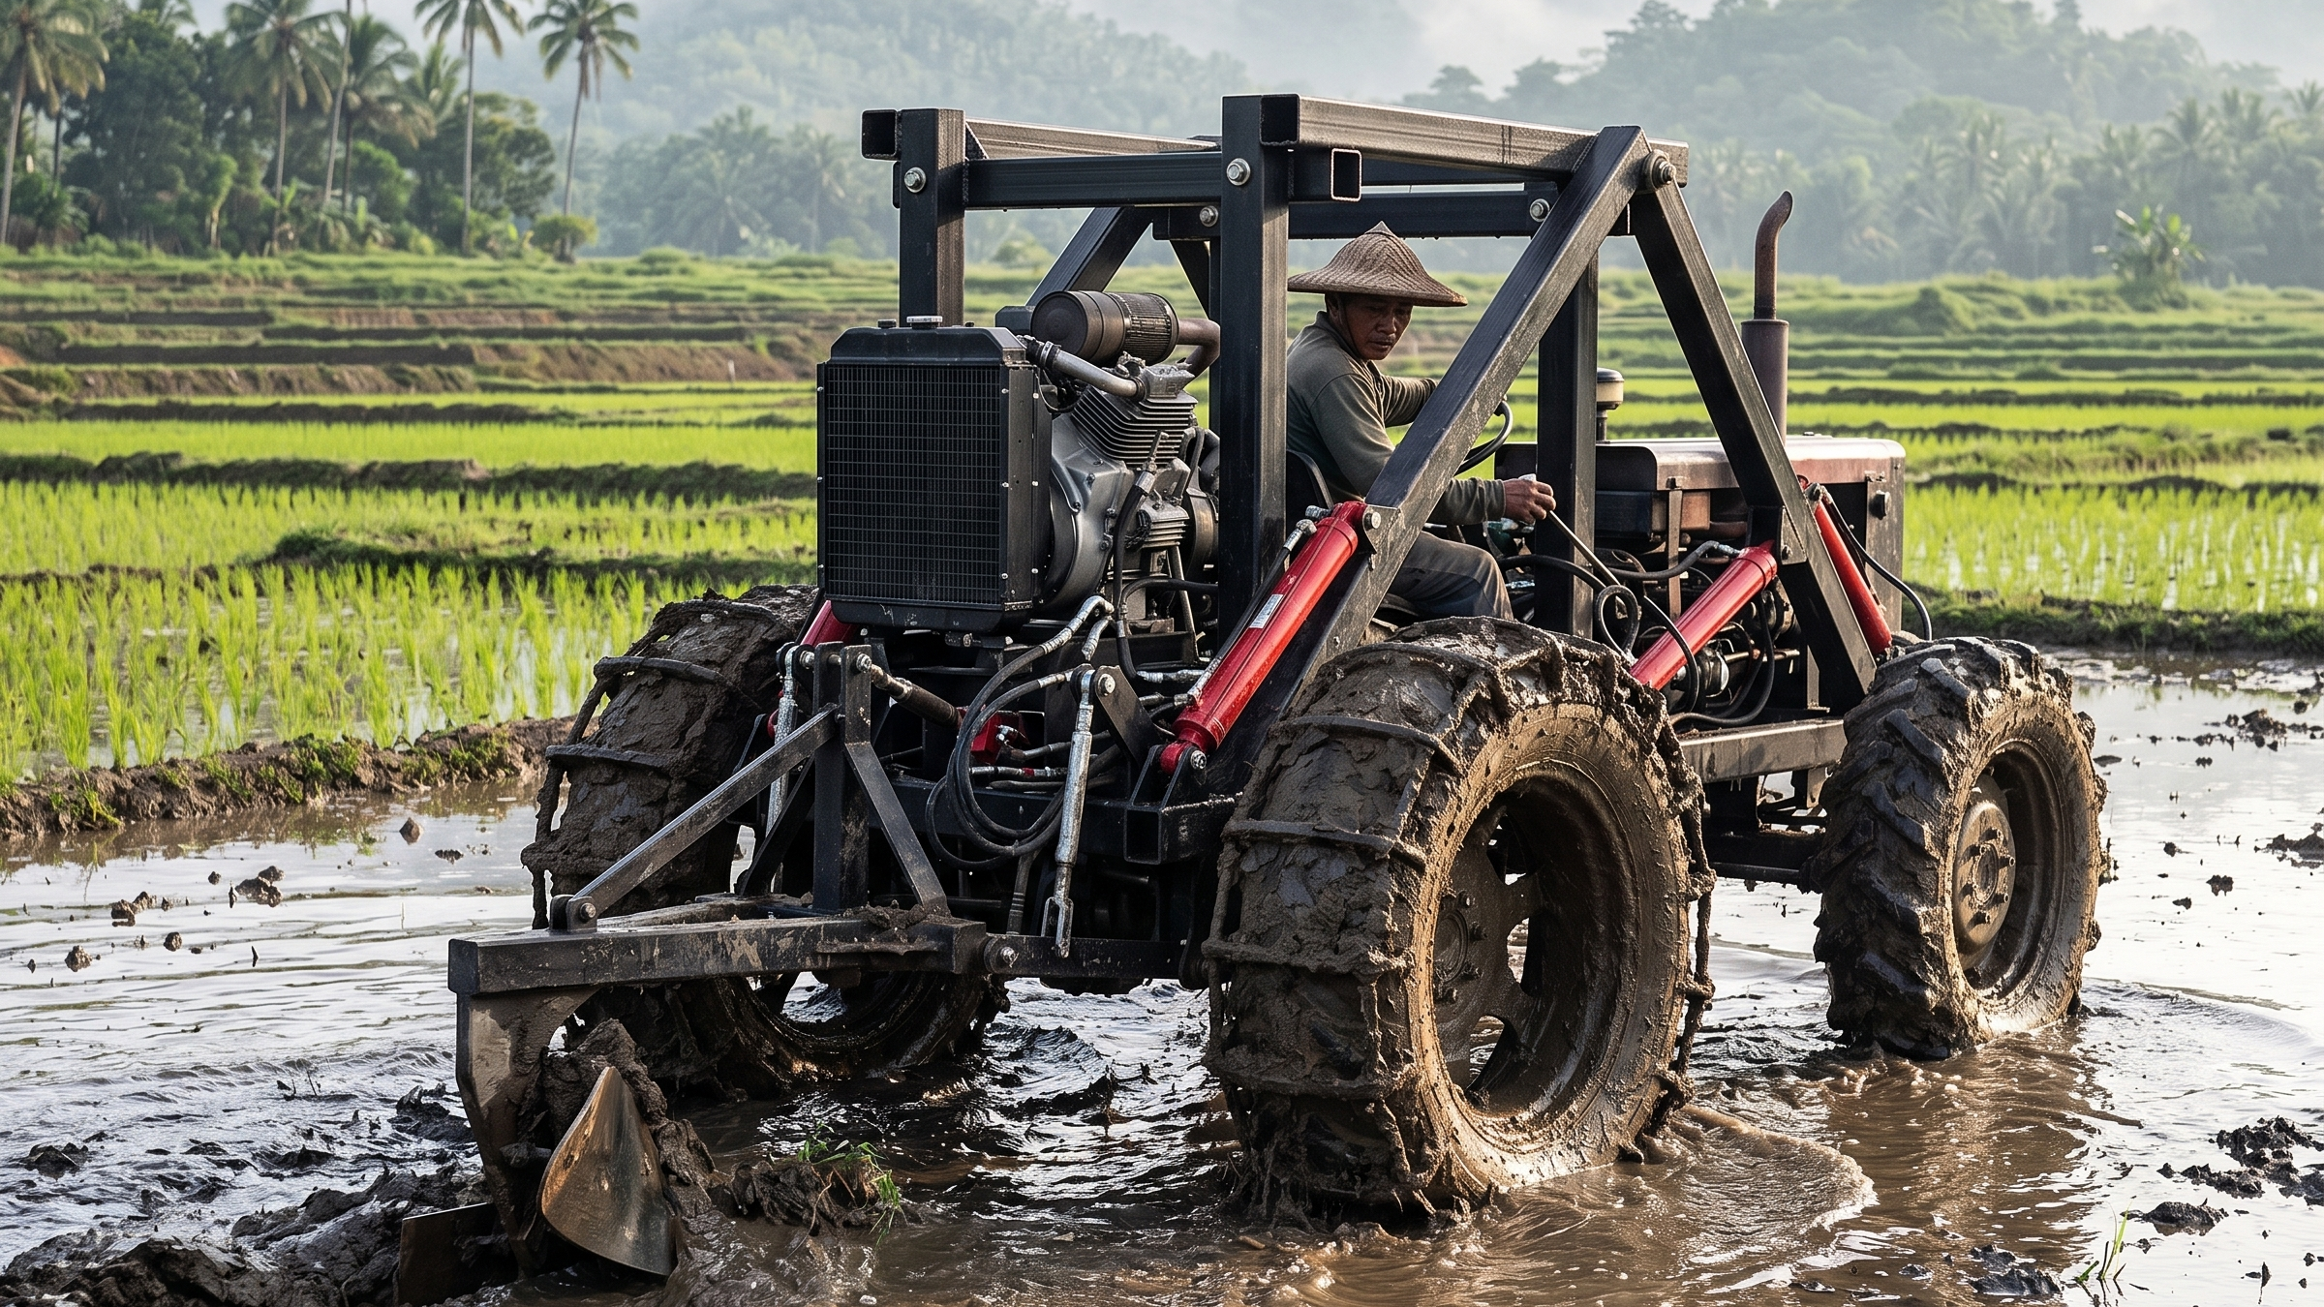
LIFETRAC The Open Source Mini Tractor
Affordable for government programs. Built by local workshops. Repaired in your own town. Owned by Filipino farmers.
Open Source Ecology — Philippines | Proposal for Farmer Groups & Government Partners | September 2026
Notes:
Opening: the LifeTrac is an open-source mini tractor (OSE LifeTrac IX / MicroTrac design). Hero photo: LifeTrac concept working a flooded rice paddy. Key line: a tractor the government can afford to give farmer groups, and that local garages can keep running.

Slide 2
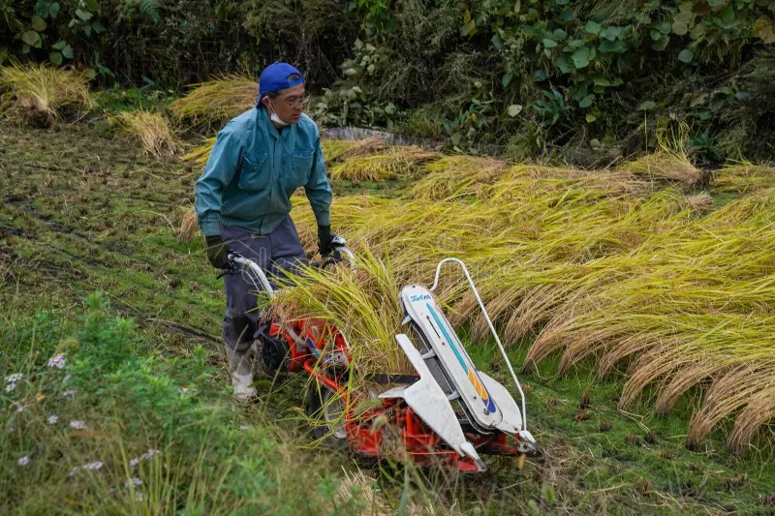
THE PROBLEM
Farming is hard, slow, and expensive without machines.
▸ Too slow — a carabao prepares only about half a hectare to one hectare a day — planting windows are missed (estimate).
▸ Too expensive — imported tractors cost hundreds of thousands of pesos — far beyond one farmer's reach.
▸ Too fragile — when an imported machine breaks, parts come from abroad. It can sit dead for a whole season.
▸ Too small to matter alone — a walking tractor (~$850) helps one farmer, but cannot pull a barangay forward.
Hand and carabao farming still feed the nation.
Open Source Ecology — Philippines | LifeTrac Proposal | Sept 2026
Notes:
Set up the pain: limited hectares/day with animal power; imported machines unaffordable and unrepairable locally. Walking tractor price from made-in-china.com reference pages in REFERENCES/. Hectare figures are estimates — say so.

Slide 3
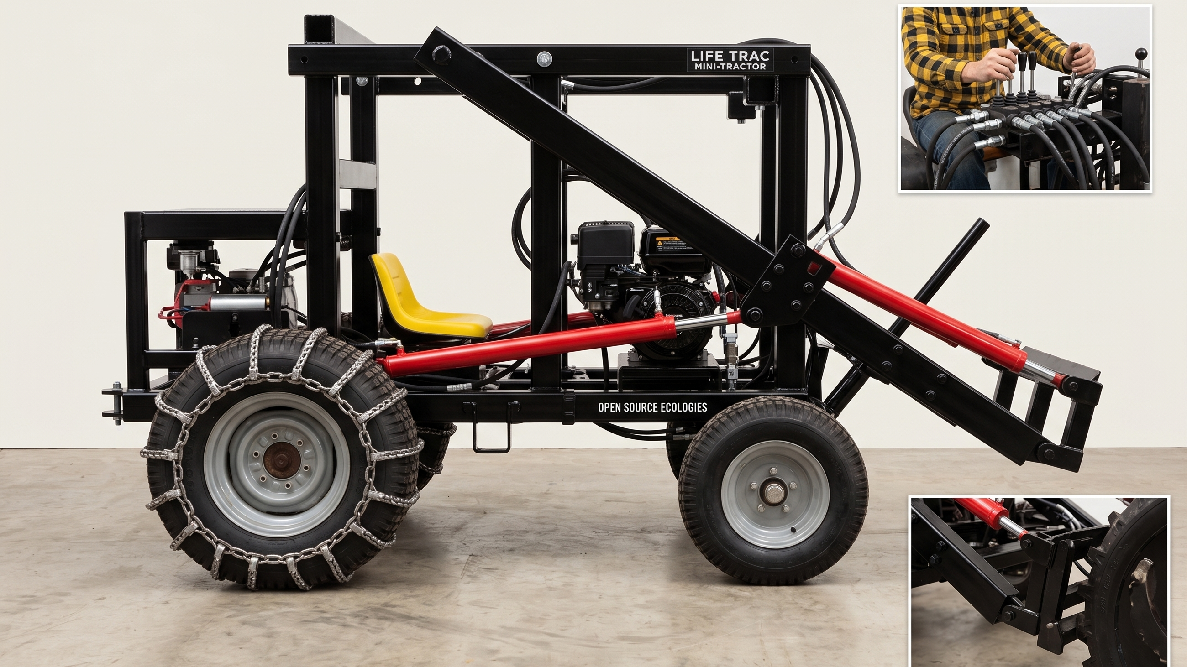
THE MACHINE
A tractor you can build — and fix — in your own town.
Free open-source plans (Open Source Ecology) • welded steel frame + hydraulic muscle • quick-attach tools in minutes • compact size fits small paddies and narrow farm roads
Notes:
Based on OSE LifeTrac IX / MicroTrac v17.10: compact tracked utility tractor, ~41 in wide, Power Cube 16-27 hp, hydraulic quick-attach. Studio photo shows the actual machine layout: frame, engine, hydraulic levers, attachment plate.

Slide 4
AFFORDABLE FOR GOVERNMENT
One budget. Machines for many groups — and jobs in every town.
LifeTrac — materials + direct labor ONLY
₱247,548
excludes indirect labor, overhead, tooling, trial and error
LifeTrac — realistic all-in, first units
₱900,000
the honest number to budget a pilot against
Imported Chinese mini loader (landed, ready to work)
₱312,000
Estimates, Sept 2026 research (₱62.51/USD). Import range ₱281,000–₱343,000 (Rippa RS06 class, delivered). We are NOT cheaper today: ₱247,548 is a price-optimized direct-cost model, and our own conservative draft BOM for the same machine reads ~₱358,000 materials before any labor.
▸ Cheaper later, not yet — we get below the import price at economic quantities — the way the Chinese did. That is what the subsidy buys.
▸ Every peso stays home — steel, labor, and parts are paid to Filipino workshops, not foreign factories.
▸ At parity, lifetime wins — local repair, local parts, no import downtime — but only once the price is there.
Open Source Ecology — Philippines | LifeTrac Proposal | Sept 2026
Notes:
CORRECTION (Justin, 2026-09-10). The ₱247,548 figure was being presented as if it were a comparable all-in cost. It is not: it is materials (₱194,548) plus ₱53,000 of DIRECT labor from a price-optimized model — it excludes indirect labor, overhead, tooling, and the trial and error every first build consumes. Our own conservative draft BOM (boms/microtrac-bom-ph-v1.0.md) reads ~₱358,000 materials, ₱420,000 with contingency, for the same machine and before any labor at all. Against a Chinese mini loader that lands finished, tested and warranted at ₱281k–343k, we are MORE expensive today. Say that plainly. The research's own executive recommendation is to WAIT until the Power Cube interface is engineered. The honest first-unit number is ~₱900,000 all-in, and it falls with economic quantities and local content.

Slide 5
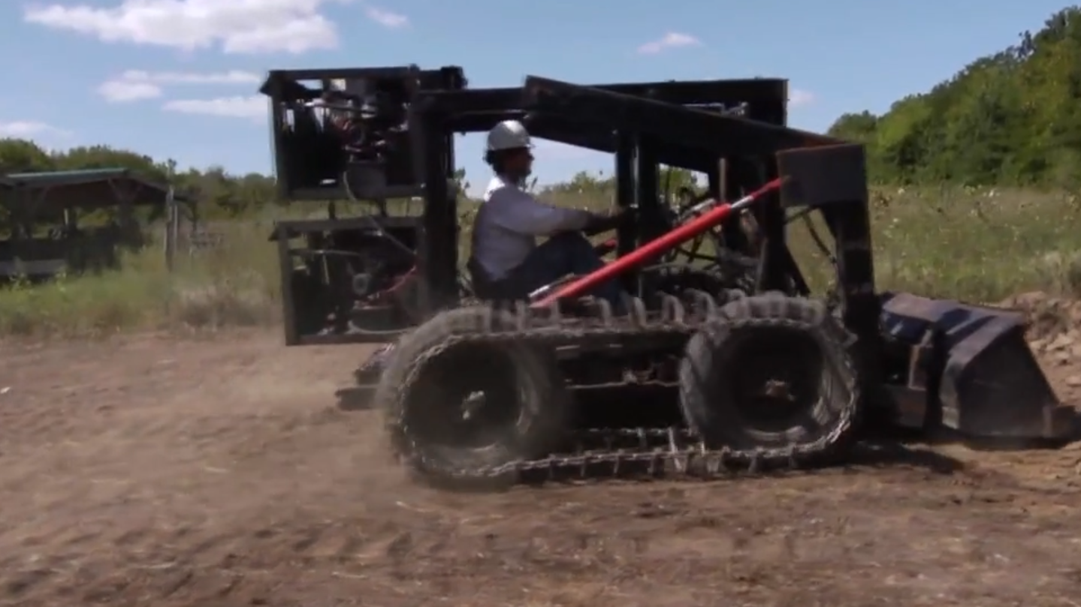
LOCAL JOBS, LOCAL REPAIR
When it breaks, your own town fixes it.
Free plans + hands-on training for local workshops and garages • common parts from local suppliers • every repair peso becomes a local job, not a foreign invoice.
Notes:
Photo: real LifeTrac prototype in the field (OSE build video frame). Because the design is open source, any welding shop can fabricate and any mechanic can be trained. Parts already mapped to PH suppliers: Banawe steel, Ranflex Metals, Shopee/Lazada hydraulics (BOM v1.0).

Slide 6
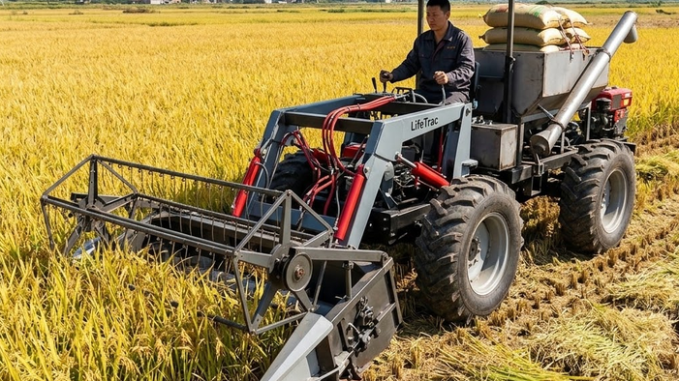
PRODUCTIVITY
Finish the field before the rain comes.
Mechanized land preparation covers many hectares per day instead of one (estimate) • a few machines lift the yield of the whole barangay • on-time planting means bigger harvests.
Notes:
Photo: LifeTrac with harvester attachment in a ripe rice field. Core farmer benefit: more hectares per day, tighter planting windows met, higher yield. Hectares/day figures are estimates — commit to measuring them in the pilot.

Slide 7
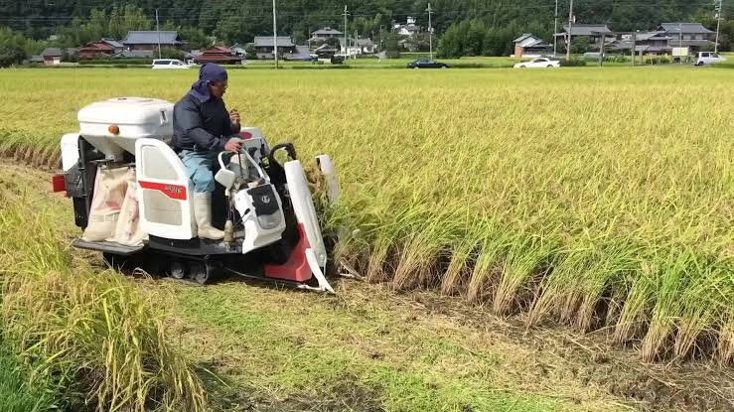
THE SHARING MODEL
Not every farm needs its own tractor. Every farmers' group needs one.
▸ Group ownership — a subsidized LifeTrac belongs to the farmers' association or cooperative — not economical individually, powerful together.
▸ An old tradition — carabaos never worked just one farm — the tractor follows the same shared custom.
▸ Cost per hectare falls — sharing spreads the cost across many hectares and many families.
▸ Scale grows — groups take on bigger combined areas, negotiate better prices, and sell together.
One machine, many farms — like the shared carabao.
Open Source Ecology — Philippines | LifeTrac Proposal | Sept 2026
Notes:
The subsidy unit is the farmer group / cooperative, not the individual. Anchors the proposal in the familiar shared-carabao tradition. Image: small combine harvester working a village field.

Slide 8
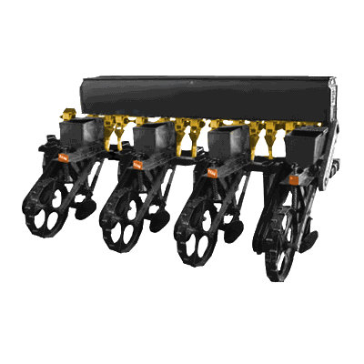
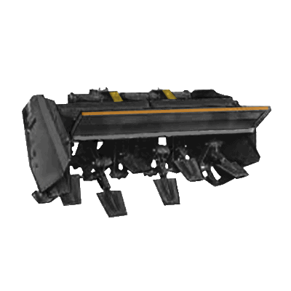
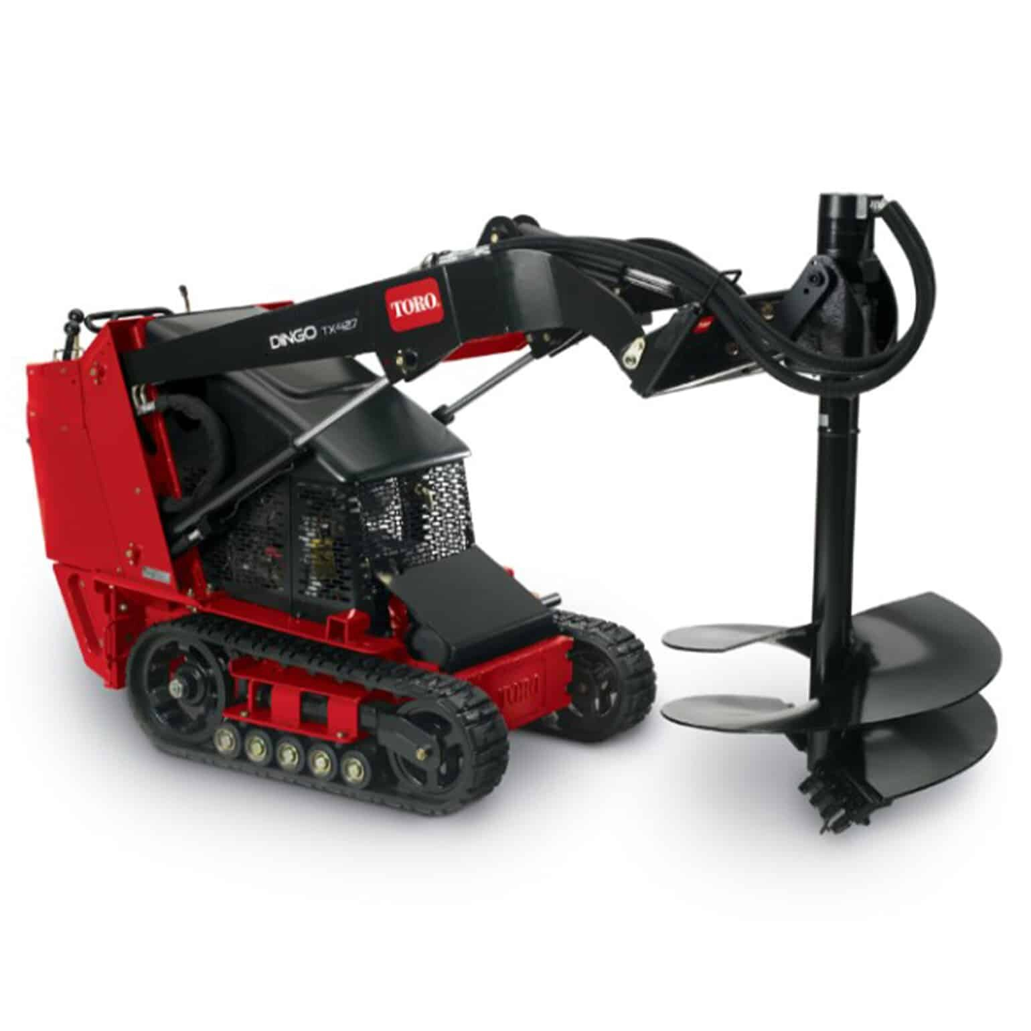
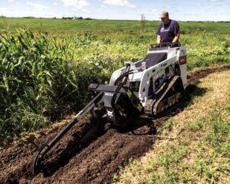
ATTACHMENTS
One machine, many jobs — swap tools in minutes.
Seeder
Spader / Tiller
Auger
Trencher
plant rows of seed fast and evenly
prepare seedbeds in one pass
drill holes for posts and trees
cut irrigation and drainage ditches
Plus: bucket, pallet forks, plow, trailer. Attachment photos show tool concepts on comparable compact machines.
Open Source Ecology — Philippines | LifeTrac Proposal | Sept 2026
Notes:
Hydraulic quick-attach plate takes many tools. Seeder/Spader are LifeTrac attachment renders; auger (Toro Dingo) and trencher (Bobcat MT55) photos show the same attachment types on comparable commercial compact loaders — concept reference only, not the product offered.

Slide 9
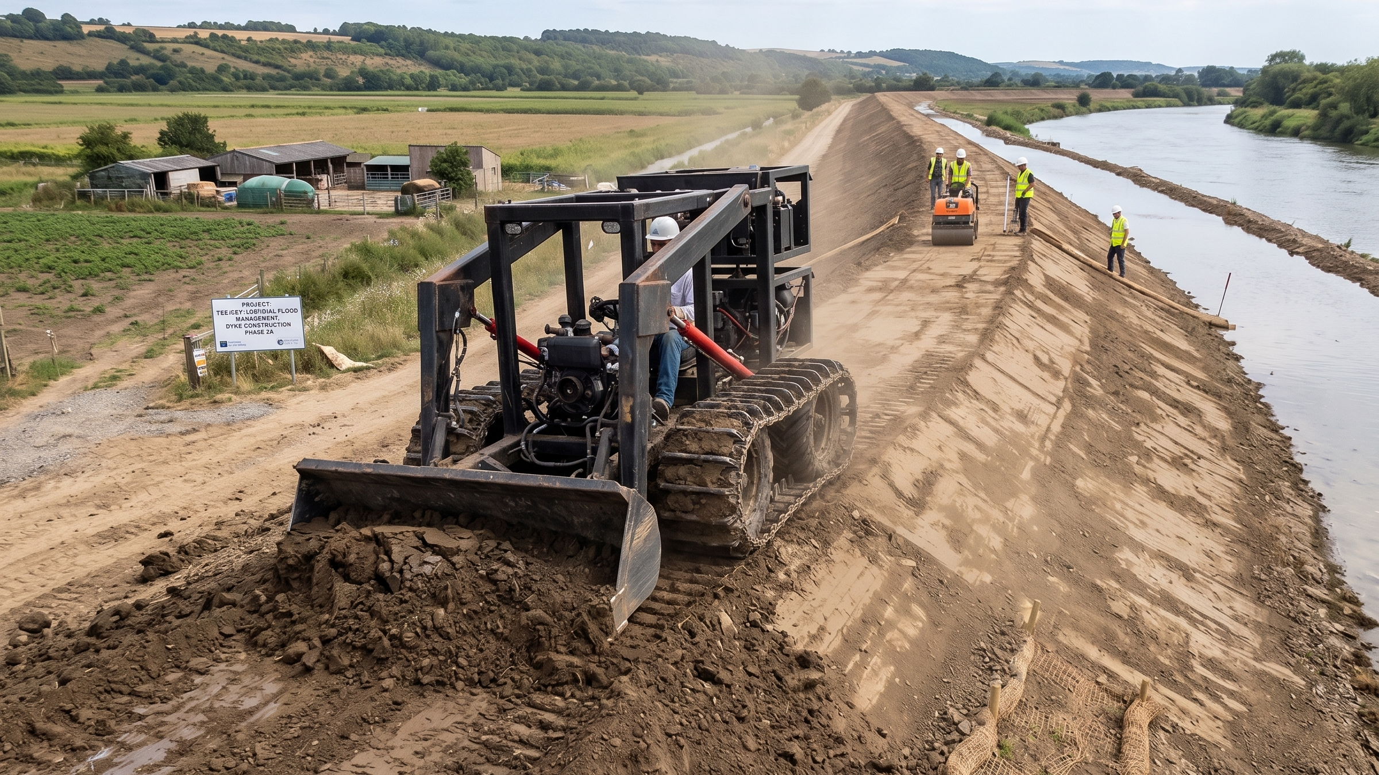
OFF-SEASON WORK
The tractor that works even when the farm rests.
Farm-to-market road repair • earthmoving and landscaping • dykes and earthworks • flood-control projects before the storms arrive.
Notes:
Photo: LifeTrac with dozer bucket on a flood-management dyke construction project. Off-season utilization is what makes the economics work for the government: the same asset serves LGU public works — roads, dykes, drainage — when fields don't need it.

Slide 10
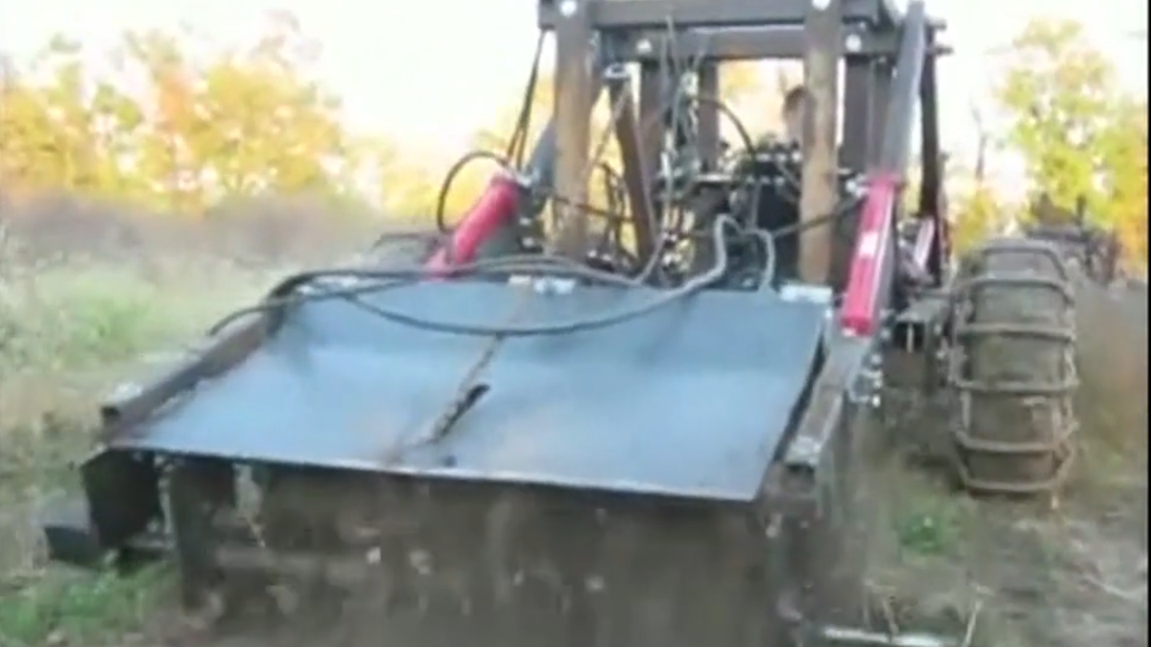
FUTURE-PROOF
Ready for tomorrow's farming.
Remote operation
Drone operation
LiDAR mapping
Night operations
drive from the shade — safer in heat, mud, and floods
scout fields and plan work from the air
precise land leveling, even in the dark
run around the clock to beat storm deadlines
Notes:
Photo: LifeTrac tilling at dusk — leads into night-ops story. Because the machine is open source, automation modules (remote control, drone scouting, LiDAR, night operation kits) can be added by local engineers — no permission needed from any foreign vendor. Goal: process as many hectares as possible inside tight weather windows.

Slide 11
ECONOMICS & SUSTAINABILITY
Honest math: imports are cheaper today. Local is stronger — and gets cheaper at volume.
▸ Today — a local build costs MORE than a Chinese import (estimates, Sept 2026) — we will not pretend otherwise.
▸ Why — our ₱247,548 headline counts materials and direct labor only; add indirect labor, overhead and trial-and-error and the first units run well above the ₱281k–₱343k the import lands at.
▸ The difference — repairs and maintenance happen in your town. Less downtime, local jobs, skills that stay.
THE PATH TO BEATING IMPORT PRICES
① Economic quantities — build in batches, the way the Chinese industry got its costs down
② Locally produced motors — a separate engagement, and the biggest single import line
③ Local batteries — made and serviced locally; swap and keep working (separate engagement)
④ Local content + investment — with sufficient investment we reach Chinese-level costs and keep the money here
Open Source Ecology — Philippines | LifeTrac Proposal | Sept 2026
Notes:
This is the credibility slide: admit the import is cheaper TODAY, then show the roadmap. CORRECTION (Justin, 2026-09-10): the previous wording said 'about the same as a Chinese import'. That understated it — we are more expensive, because ₱247,548 is a price-optimized direct-cost model that excludes indirect labor and overhead, and our own conservative draft BOM reads ~₱358,000 materials alone. Local motors and local batteries are SEPARATE engagements, not part of the two-year scope — say so. Electric path documented in docs/11-openmotor-ph-manufacturing.md, docs/12-microtrac-electric-vs-ice.md, and Open-Source-Electric-Motors deep research (7.5-15kW).

Slide 12
THE PROPOSAL
Let's put a LifeTrac in every farmers' group.
PILOT COST PER UNIT (estimate): ₱250k materials → ₱300k+ with labor → ~₱900k all-in once overhead and trial-and-error are counted — the honest number until our engineering processes and workshop tooling mature.
BUILD: build 2–5 pilot units with local workshops. Any workshop in the Philippines with the minimum tools can build it — they cannot mass-produce it, but they can certainly build it.
TRAIN & DEPLOY: certify local mechanics with every unit; subsidized units to pilot farmer associations — measured in hectares per day and cost per hectare.
PARTNER TO SCALE: those who want to mass-produce it join the partnership — that is what drives the price down and helps subsidize the farmers.
Notes:
Correction (Justin, 2026-09-10): the ₱250k figure was materials-only. Honest ladder — ₱250k materials, ₱300k+ with labor, ~₱900k all-in once overhead and trial-and-error are counted; that ×3 holds until our engineering processes mature and any Philippine workshop with the minimum tools can build the machine. Workshops can BUILD it but cannot mass-produce it; mass-production partners join the partnership that subsidizes farmers. Close with the concrete ask: a funded pilot — 2-5 machines, training per unit, deployment to farmer associations, and public measurement (hectares/day, cost/hectare, uptime).

