Slide 1
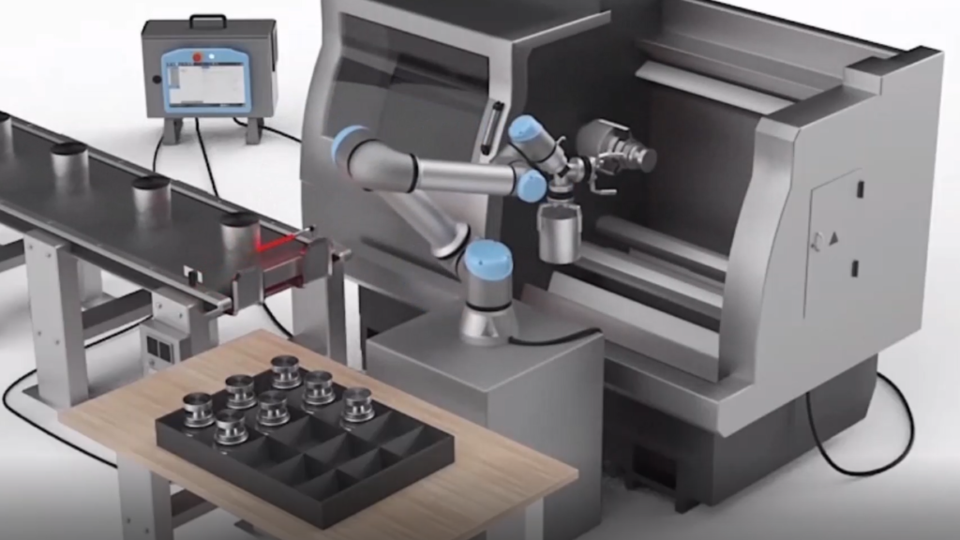
COBOT PROCUREMENT
GUIDE FOR FURNITURE
CNC AUTOMATION
A Staff Toolkit for Evaluating Shenzhen Robot
Consultants & Selecting the Right Collaborative Robot
JULY 2026 / FURNITURE MANUFACTURING

Slide 2
YOUR EVALUATION ROADMAP
What's Inside
01
02
Our CNC Tending Challenge
Robot Selection Guide
Understanding what we need to automate and why a cobot is the right solution for our furniture plant
How to match the right cobot model to our furniture panels, reach requirements, and budget
03
04
Evaluating Shenzhen Consultants
Business Case & ROI
How to find, vet, and select the right robot integrator among Shenzhen's 40+ specialists
The numbers that justify this investment: costs, payback timelines, and expected production gains

Slide 3
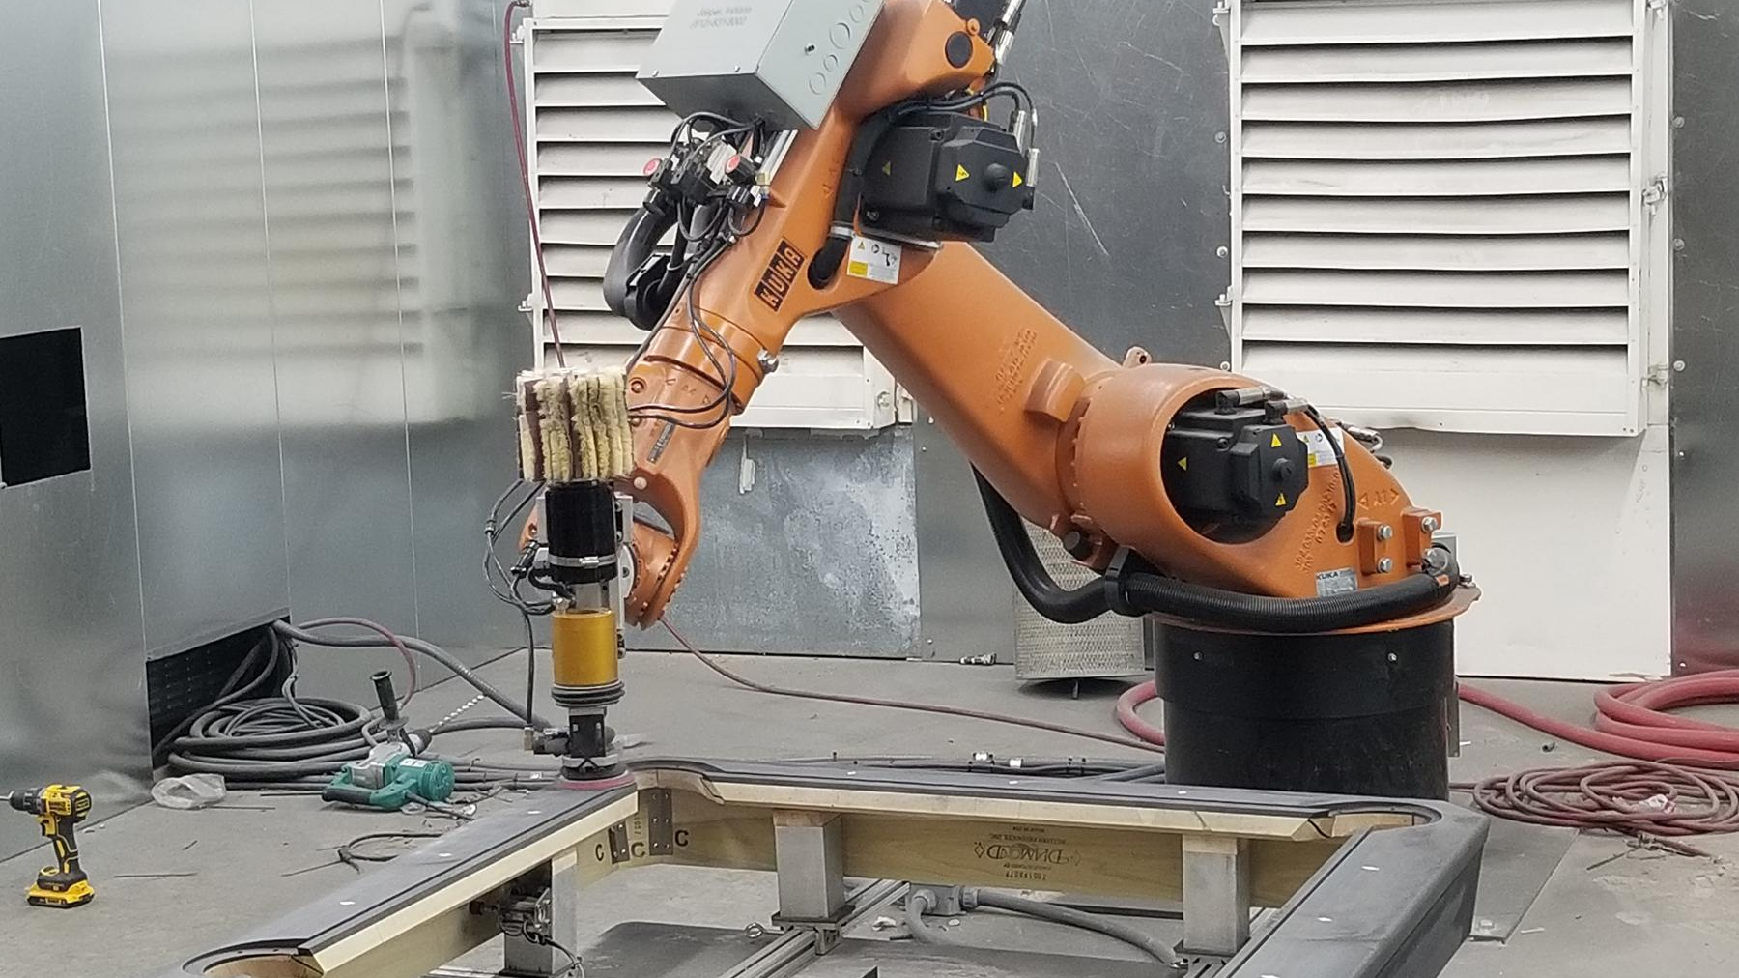
01
OUR CNC TENDING CHALLENGE
Understanding what we need to automate and why a cobot is the right solution

Slide 4
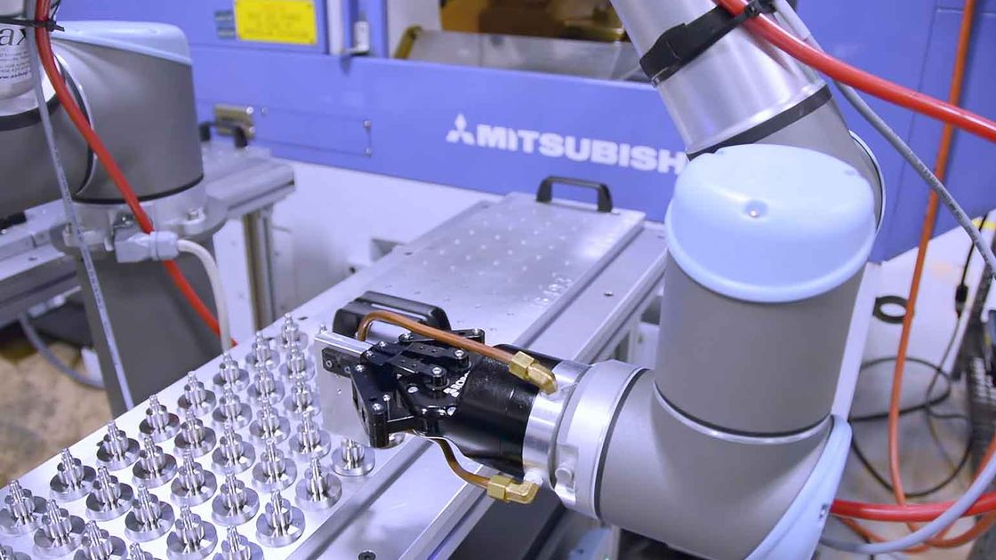
What We Are Automating: CNC Loading & Unloading
Our Process Today
Operators manually load raw wood panels into CNC routers, wait for the cutting/drilling cycle, then unload finished parts. This creates several problems:
▶ Operator fatigue from repetitive lifting of 10–40kg panels
▶ Inconsistent loading affects cut quality and increases scrap
▶ Dust exposure during manual handling
▶ Spindle idle time — machines wait for the next panel
The Cobot Solution
A cobot cell sits beside the CNC machine, picks panels from a feeder, loads them precisely, waits for the cycle, then unloads — all without human intervention.
60%
90%
+50%
24/7
Current Spindle Utilization
With Cobot Tending
More Output Potential
Lights-Out Possible
04

Slide 5
Furniture Panel Weight Determines Robot Size
Required Payload = (Panel Weight + Gripper Weight) x 1.25 Safety Factor
Recommended Robot Payload
Component Type | Panel Wt. | Robot
Small parts | ~3 kg | 5-7 kg
Cabinet sides / shelves | ~9 kg | 10-12 kg
Wardrobe doors / tops | ~20 kg | 20-30 kg
Full sheets / countertops | ~36-50 kg | 40-60 kg
Key Insight: 70-80% of our production falls in the 3-20kg range — perfect for a 10-12kg collaborative robot.
05

Slide 6
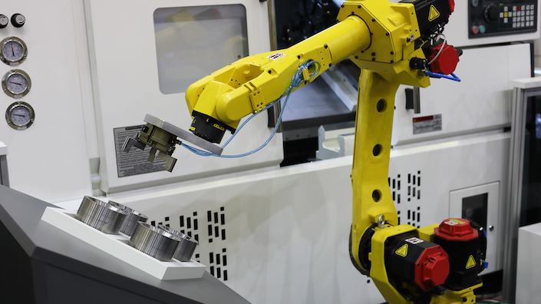
02
ROBOT SELECTION GUIDE
How to match the right cobot model to our furniture panels and budget

Slide 7
Top 6 Cobot Models for Our Application
Model | Brand | Origin | Payload | Reach | Repeatability | Price (USD) | Best For
CR10 | Dobot | Shenzhen | 10 kg | 1,300 mm | ±0.02 mm | $15K–$25K | Medium panels, ease of use
CS612 | Elite | China | 12 kg | 1,304 mm | ±0.05 mm | $18K–$32K | Heavier panels, IP65 rated
Zu 12 | JAKA | China | 12 kg | 1,327 mm | ±0.03 mm | $12K–$36K | Compact cells, app-based
i10 | AUBO | China | 10 kg | 1,350 mm | ±0.02 mm | $14K–$38K | Open architecture
UR10e | UR | Denmark | 10 kg | 1,300 mm | ±0.03 mm | $35K–$45K | Widest ecosystem
CRX-10iA/L | FANUC | Japan | 10 kg | 1,418 mm | ±0.02 mm | $35K–$50K | Deep CNC integration
Recommendation |  |  |  |  |  | Start with 10-12kg | Chinese cobot first
Our Pick: Dobot CR10 (Shenzhen-based, 55,000+ units shipped, 100+ countries, user-friendly programming, competitive pricing)
07

Slide 8
Chinese vs. International Brands: What You Get
Factor-by-Factor Comparison
Complete Cell Cost Comparison
Factor | Chinese Brands | Western Brands
Hardware Cost (10kg) | $12K–$38K | $35K–$50K
Complete Cell Cost | $29K–$58K | $57K–$97K
Safety Fencing | Minimal / None | Minimal / None
Programming | Intuitive, drag-and-drop | Moderate complexity
Integration Time | 1–2 days to weeks | Weeks to months
Spare Parts Availability | Fast from Shenzhen | Slower, higher cost
Best For | First automation, SMEs | High-volume, dedicated
Bottom Line: Chinese cobots offer 30–50% cost savings with comparable payload, reach, and repeatability. For our first automation project, they are the lower-risk, higher-ROI choice.
08

Slide 9
Complete Cell Cost: $29K–$58K for Chinese Cobot Solution
BUDGET
STANDARD — RECOMMENDED
PREMIUM
~$30,000
~$45,000
~$58,000
✓ 10kg Chinese cobot (Dobot/JAKA)
✓ Single vacuum gripper
✓ Basic tray feeder
✓ Basic I/O interface
✓ Standard safety
✓ Basic integration
✓ 1-day training
Good for: First automation, proving ROI, single machine
✓ 12kg Chinese cobot (Elite/JAKA)
✓ Dual gripper system
✓ Drawer magazine (160-250 parts)
✓ Ethernet machine interface
✓ Area scanner safety
✓ Full integration + programming
✓ 3-day comprehensive training
Good for: Production scale-up, longer unattended runs
✓ Multi-machine tending
✓ Advanced vision system
✓ Automated conveyor feeder
✓ Full PLC integration
✓ Complete safety enclosure
✓ Turnkey installation
✓ On-site training + support
Good for: High-volume dedicated lines
Additional Costs: Shipping to Philippines ~$500–$1,500 | Import duty: 0% under RCEP for BOI-registered enterprises | On-site commissioning: ~$1,500–$3,000

Slide 10

03
EVALUATING SHENZHEN CONSULTANTS
How to find, vet, and select the right robot integrator in Shenzhen

Slide 11
The Shenzhen Robot Ecosystem: 40+ Integrators Ready to Help
The "Shenzhen Army"
Shenzhen has over 40 established system integrators — the largest and most advanced contingent in China. These companies don't just sell robot arms — they analyze your process, match the right robot, design custom end-of-arm tooling, handle PLC programming, and deliver turnkey solutions.
Shenzhen-Based Manufacturers
Dobot — 55,000+ units shipped to 100+ countries. Contact: sales@dobot-robots.com
Han's Robot — Cobots 3-12kg, CE certified
Inovance — Full automation ecosystem (PLC, servo, CNC)
Key Integrators to Contact
Leibo Technology, Lianshuo Automation, Orange Automation, Siprui Robot, Jashi Robot, Rongde Robot, Shengterida
40+
System Integrators
100+
Countries Exported To
55K+
Dobot Units Shipped Globally
First Contact: Dobot — sales@dobot-robots.com | Website: dobot-robots.com | Listed on HK Stock Exchange (SEHK: 2432)
11

Slide 12
Evaluation Checklist: 10 Questions to Ask Every Consultant
1. Experience: Have you done CNC tending for furniture or woodworking before? Ask for photos, videos, or references.
2. Robot Recommendation: What models do you recommend for our panel sizes and why? They should explain payload/reach calculations.
3. References: Can you provide references from Southeast Asia or similar furniture manufacturers?
4. Quotation Detail: Is your quote line-itemized? It must include robot, gripper, feeder, interface, safety, integration, and training.
5. Installation Support: Do you provide on-site commissioning at our Philippines facility? What does it cost?
6. Warranty & Parts: What is the warranty period? How quickly can you ship spare parts to the Philippines?
7. Language: Can your team communicate in English? Are manuals and programming interfaces available in English?
8. Lead Time: What is the production and shipping timeline from order to delivery at our facility?
9. Certifications: Do you provide CE certification, export documentation, and HS codes for Philippine customs?
10. Training: What operator training do you provide? Is it included in the price or an extra cost?
Pro Tip: Document all answers in writing. Ask for a video call to see their facility. Request a Factory Acceptance Test (FAT) report before shipment.
12

Slide 13
Red Flags: Warning Signs to Walk Away
Cannot explain payload/reach calculations — they don't understand your application
No reference installations or video proof of similar projects
Vague quotation — no line-item breakdown of components and costs
No CE certification or export documentation experience
Requires 100% payment upfront — standard is 30-50% deposit
Cannot provide English documentation or communication
Unrealistic ROI promises — e.g., "payback in 1 month"
No remote technical support capability after installation
How to Verify a Supplier Online
▶ On Alibaba / Made-in-China: Look for Trade Assurance, Verified Manufacturer badges, and video documentation of systems in operation
▶ Request a video call before placing any order — see their facility and team
▶ Start with a small purchase (single robot arm) before committing to a full integrated cell
▶ Check if they have export experience to Southeast Asia — ask for shipping records or customer references
13

Slide 14
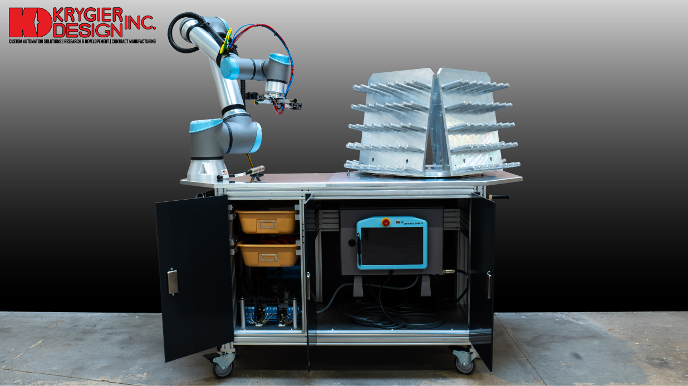
04
BUSINESS CASE & ROI
The numbers that justify this investment to management

Slide 15
Complete Cell Cost: $29K–$58K for Chinese Cobot Solution
BUDGET
STANDARD — RECOMMENDED
PREMIUM
~$30,000
~$45,000
~$58,000
✓ 10kg Chinese cobot (Dobot/JAKA)
✓ Single vacuum gripper
✓ Basic tray feeder
✓ Basic I/O interface
✓ Standard safety
✓ Basic integration
✓ 1-day training
Good for: First automation, proving ROI, single machine
✓ 12kg Chinese cobot (Elite/JAKA)
✓ Dual gripper system
✓ Drawer magazine (160-250 parts)
✓ Ethernet machine interface
✓ Area scanner safety
✓ Full integration + programming
✓ 3-day comprehensive training
Good for: Production scale-up, longer unattended runs
✓ Multi-machine tending
✓ Advanced vision system
✓ Automated conveyor feeder
✓ Full PLC integration
✓ Complete safety enclosure
✓ Turnkey installation
✓ On-site training + support
Good for: High-volume dedicated lines
Additional Costs: Shipping to Philippines ~$500–$1,500 | Import duty: 0% under RCEP for BOI-registered enterprises | On-site commissioning: ~$1,500–$3,000

Slide 16
ROI: 9-Month Payback with 30–50% More Output
9 Months
60% → 90%
$6K–$10K
50–80%
Payback Period
(Chinese Cobot Cell)
Spindle Utilization
(+30–40% more output)
Annual Labor Savings
(per machine, 2 shifts)
Scrap Reduction
(consistent loading)
Cumulative ROI Over 18 Months
Additional Benefits
▶ Lights-out production — run overnight and weekends with no labor cost
▶ Eliminate repetitive strain injuries from lifting heavy panels
▶ Reduce dust exposure for operators
▶ Free skilled workers for quality inspection and maintenance
▶ Consistent cut quality — precise panel positioning every cycle
▶ Scale easily — replicate the cell across multiple CNC machines
16

Slide 17
Implementation Roadmap: Decision to Production in 8 Weeks
WEEK 1
WEEKS 1-2
WEEKS 2-6
WEEKS 6-8
WEEK 8
WEEKS 8-9
Assessment
Design & Quote
Production
Shipping
Installation
Training
Document CNC model, panel sizes, cycle times. Share photos/videos of current process with integrator.
Integrator proposes robot, gripper, feeder config. Review quotation line-by-line. Negotiate terms.
15-25 working days. Factory Acceptance Test (FAT) with 72-hour continuous operation validation.
5-10 days ocean freight to Philippines. 3-7 days customs clearance with complete documentation.
Position workstation, connect cables, install gripper, load program. 1-2 days with pre-configured system.
Train 2-3 operators on robot operation, program modification, and troubleshooting procedures.
What to Prepare Before Contacting Suppliers
✓ CNC machine brand and model number
✓ Controller brand (Fanuc, Siemens, etc.)
✓ Typical panel sizes and weights you process
✓ Current cycle times per operation
✓ Number of shifts and operators per machine
✓ Photos of the CNC machine and surrounding area
✓ Available floor space beside the machine
✓ Door opening mechanism (swing/slide/automatic)
✓ Your budget range and target timeline
✓ Power supply specifications (voltage, frequency)
17

Slide 18
READY TO START?
YOUR NEXT STEPS
1
Document your CNC machine model, panel sizes, and cycle times
2
Contact Dobot at sales@dobot-robots.com for initial assessment
3
Attend ARE Shenzhen Expo, Aug 26-28, 2026 to meet integrators
4
Budget $30K-$50K for first cell, expect 9-month ROI
"The best time to automate was yesterday. The second-best time is now."
Cobot Procurement Guide / Furniture Manufacturing / July 2026

